Slide 1
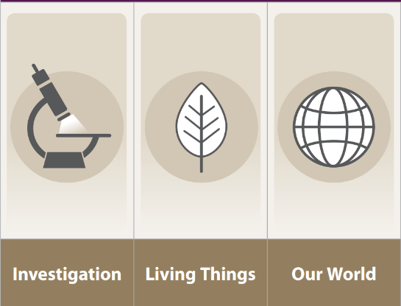
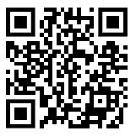
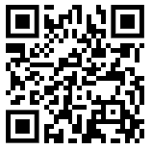
How can I present my scientific knowledge to educate others?
Yr2/3 SCIENCE KNOWLEDGE ORGANISER
Science Concepts:
Observing in Science:
Vocabulary
Use this vocabulary when discussing your Science knowledge and in your writing.
igneous rock | Rock that has been formed from lava or magma.
sedimentary rock | Rock that has been formed by layers of sediment being pressed down hard (compressed) and sticking together.
metamorphic rock | Rock that started out as igneous or sedimentary rock but changed due to being exposed to extreme heat or pressure.
lava | Molten rock that comes out of the ground is called lava.
magma | Molten rock that remains underground.
permeable | Allows liquid to pass through it.
impermeable | Does not allow liquid to pass through it.
Fair tests in Science
Investigation Variable To make a test fair we need to change one variable. | Our World Properties Things in our world can be compared to identify similarities and differences.
BBC Bitesize – lots of videos!
Science Skills:
Investigation Variable I can carry out a fair test changing only one variable. I can explain why my test is fair; which variable I changed and why. | Our World Properties I can observe and record properties through investigation to draw conclusions. I can identify differences and similarities through comparison to answer questions.

Slide 2
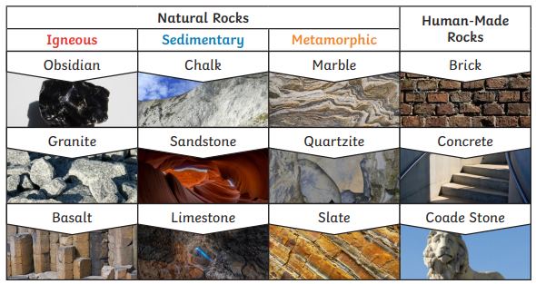
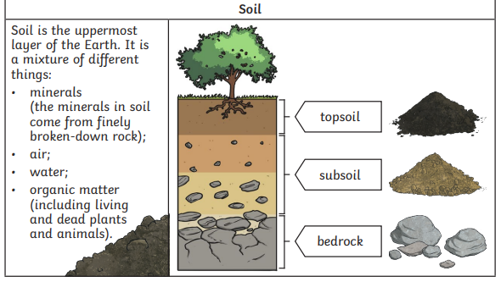
How can I present my scientific knowledge to educate others?
Yr2/3 SCIENCE KNOWLEDGE ORGANISER

